Slide 1
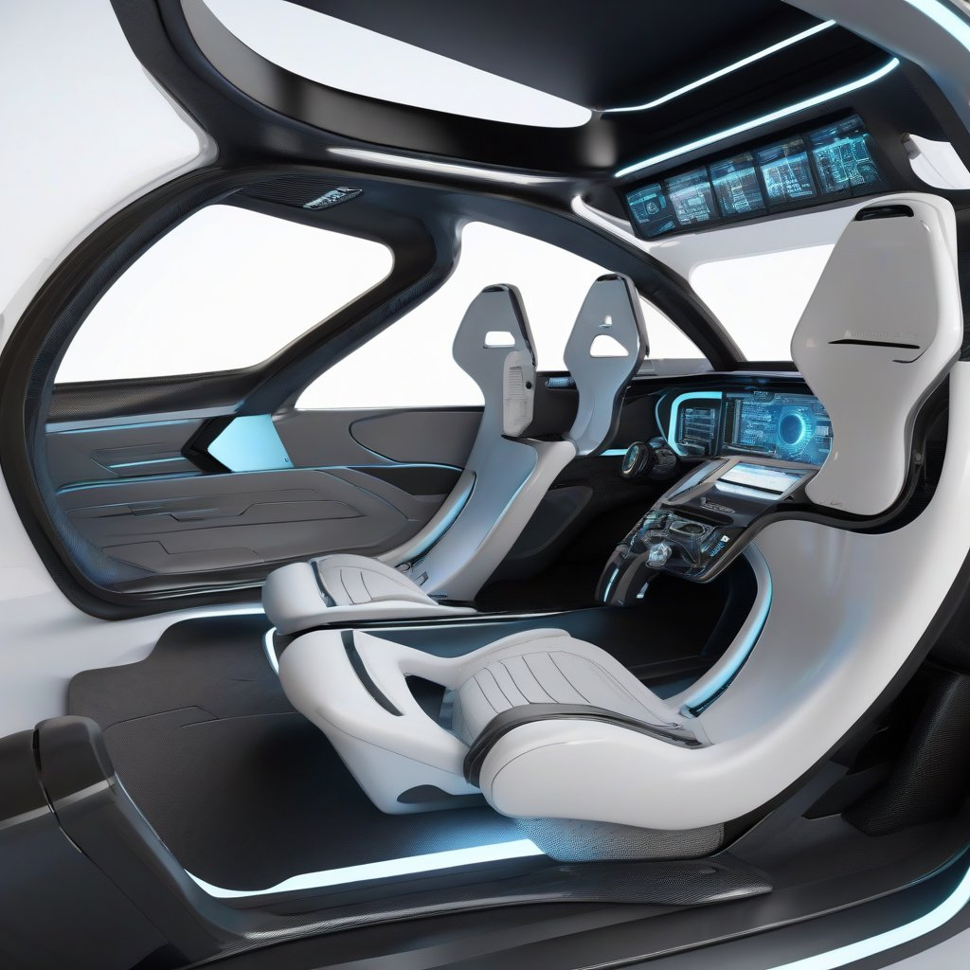

About the Potential of Large Language Models in Autonomous Driving
PhD Defense
Daniel Bauer
14.02.2024
https://huggingface.co/spaces/google/sdxl
Fast Stable Diffusion XL on TPU v5e

Slide 2
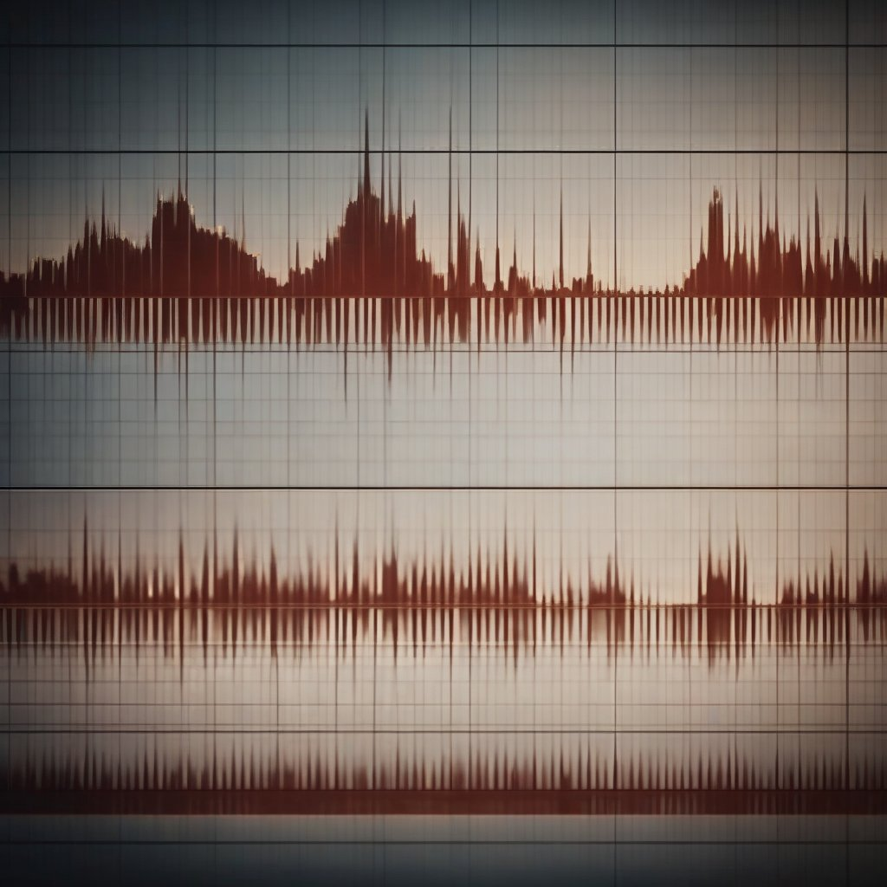
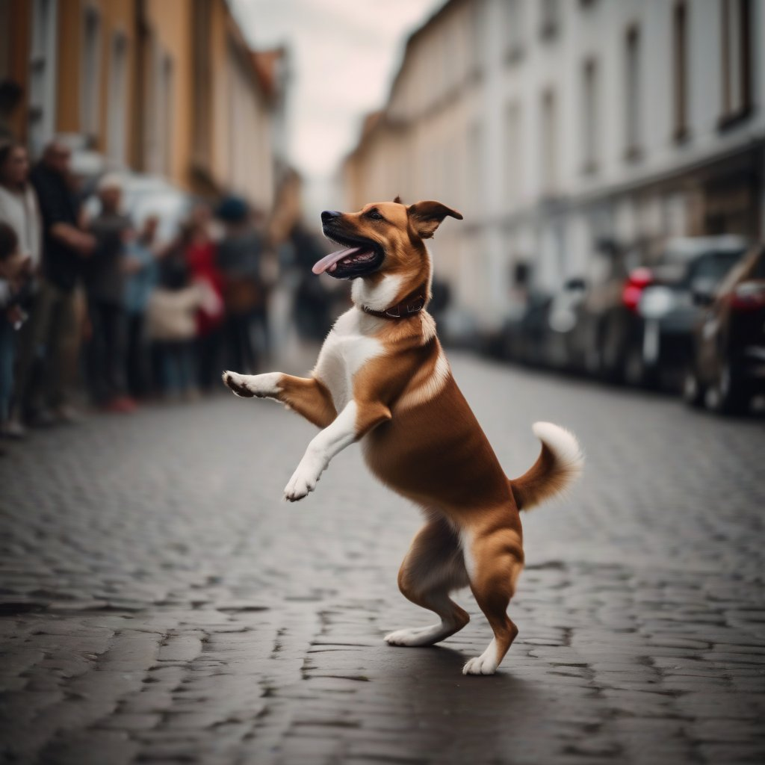


Motivation
Audio
Image
Text
What dance is the dog dancing?
3.5 years
2.5 years
2.5 years
2 years
13 months
Multimodal LLM
10 months
7 months
5 months
2.5 months
5 days
1 hour
* 1 million backers ** 1 million nights booked *** 1 million downloads
https://explodingtopics.com/blog/chatgpt-users Number of ChatGPT Users (Jan 2024)
https://huggingface.co/spaces/google/sdxl images of dog, audio waves and cat
Notes:
Time taken to reach 1 M shows that LLMS are usable and useful

Slide 3
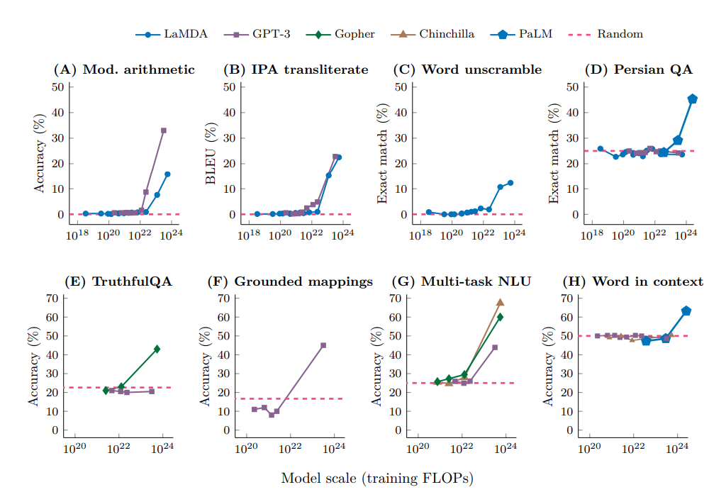
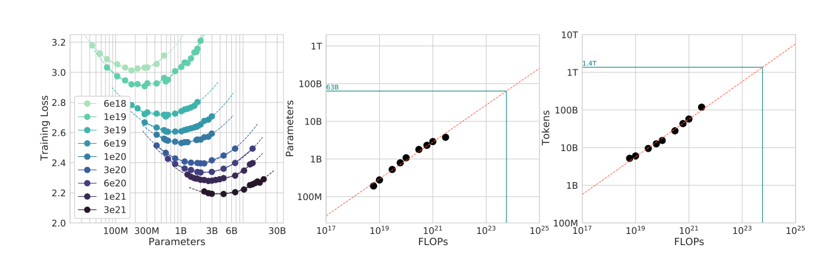
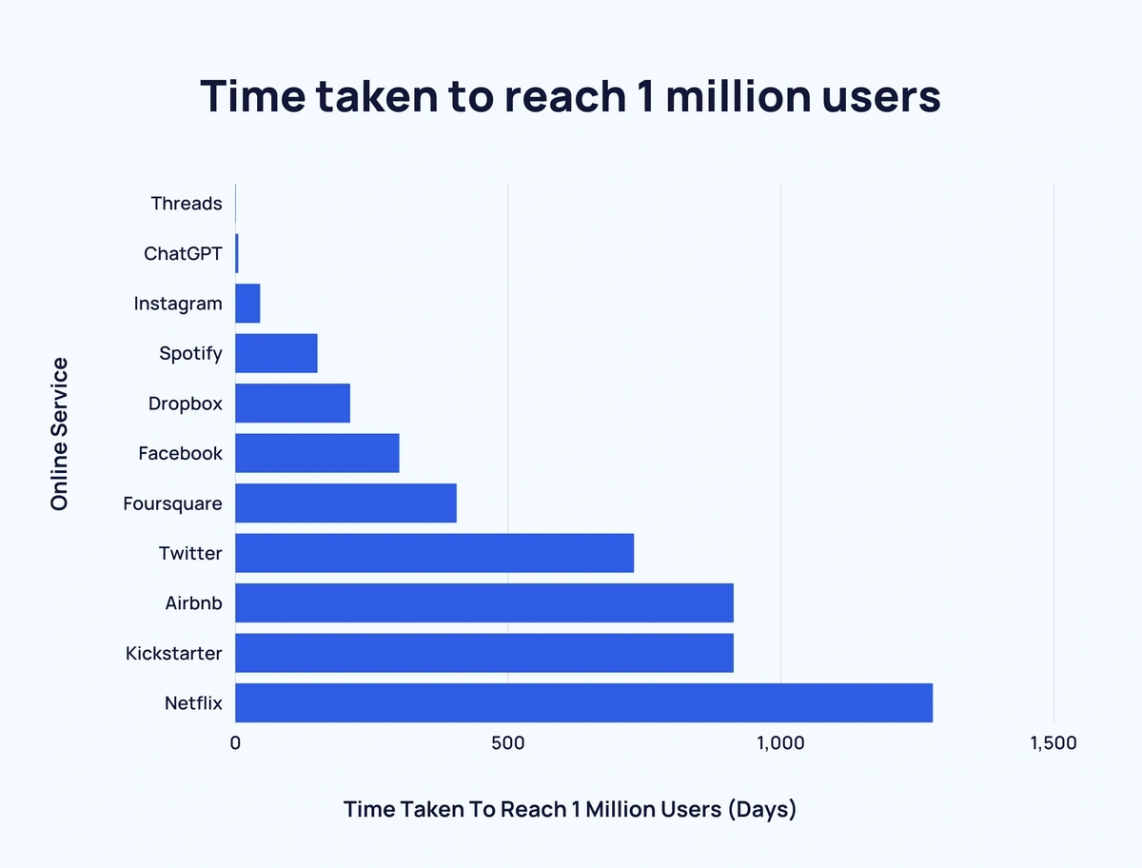
Why look into LLMs
https://arxiv.org/pdf/2203.15556.pdf Training Compute-Optimal Large Language Models
https://arxiv.org/pdf/2206.07682.pdf Emergent Abilities of Large Language Models
https://explodingtopics.com/blog/chatgpt-users Number of ChatGPT Users (Jan 2024)

Slide 4

Motivation
Image
Text
What is funny about this image? Describe it panel by panel.
3.5 years
2.5 years
2.5 years
ChatGPT-4
https://arxiv.org/pdf/2303.08774.pdf
2 years
13 months
10 months
7 months
Text
5 months
The image shows a package for a "Lightning Cable" adapter with three panels.
Panel 1: A smartphone with a VGA ...
Panel 2: The package for the "Lightning Cable" adapter with a picture of a VGA connector on it.
Panel 3: A close-up of the VGA connector with a small Lightning connector …
The humor in this image comes from the absurdity of plugging a large, outdated VGA connector …
2.5 months
5 days
1 hour
* 1 million backers ** 1 million nights booked *** 1 million downloads
https://explodingtopics.com/blog/chatgpt-users Number of ChatGPT Users (Jan 2024)
Notes:
I‘ll refere to them as LLMs
Time taken to reach 1 M shows that LLMS are usable and useful
I have to say, I have neither used ChatGpt-4 nor Gemini myself. But, reports like this encourage to dream as for example shown by Andrej Karparthy mostly known for being a founding member of OpenAI (who develop ChatGPT) and his former role as director of artificial intelligence at Tesla.

Slide 5




Motivation
Image
Text
Video
Audio
Aa
3.5 years
2.5 years
2.5 years
Gemini
https://storage.googleapis.com/deepmind-media/gemini/gemini_1_report.pdf
2 years
13 months
10 months
7 months
5 months
Image
Text
2.5 months
5 days
1 hour
Aa
* 1 million backers ** 1 million nights booked *** 1 million downloads
https://explodingtopics.com/blog/chatgpt-users Number of ChatGPT Users (Jan 2024)
Notes:
Time taken to reach 1 M shows that LLMS are usable and useful
I have to say, I have neither used ChatGpt-4 nor Gemini myself. But, reports like this encourage to dream as for example shown by Andrej Karparthy mostly known for being a founding member of OpenAI (who develop ChatGPT) and his former role as director of artificial intelligence at Tesla.

Slide 6
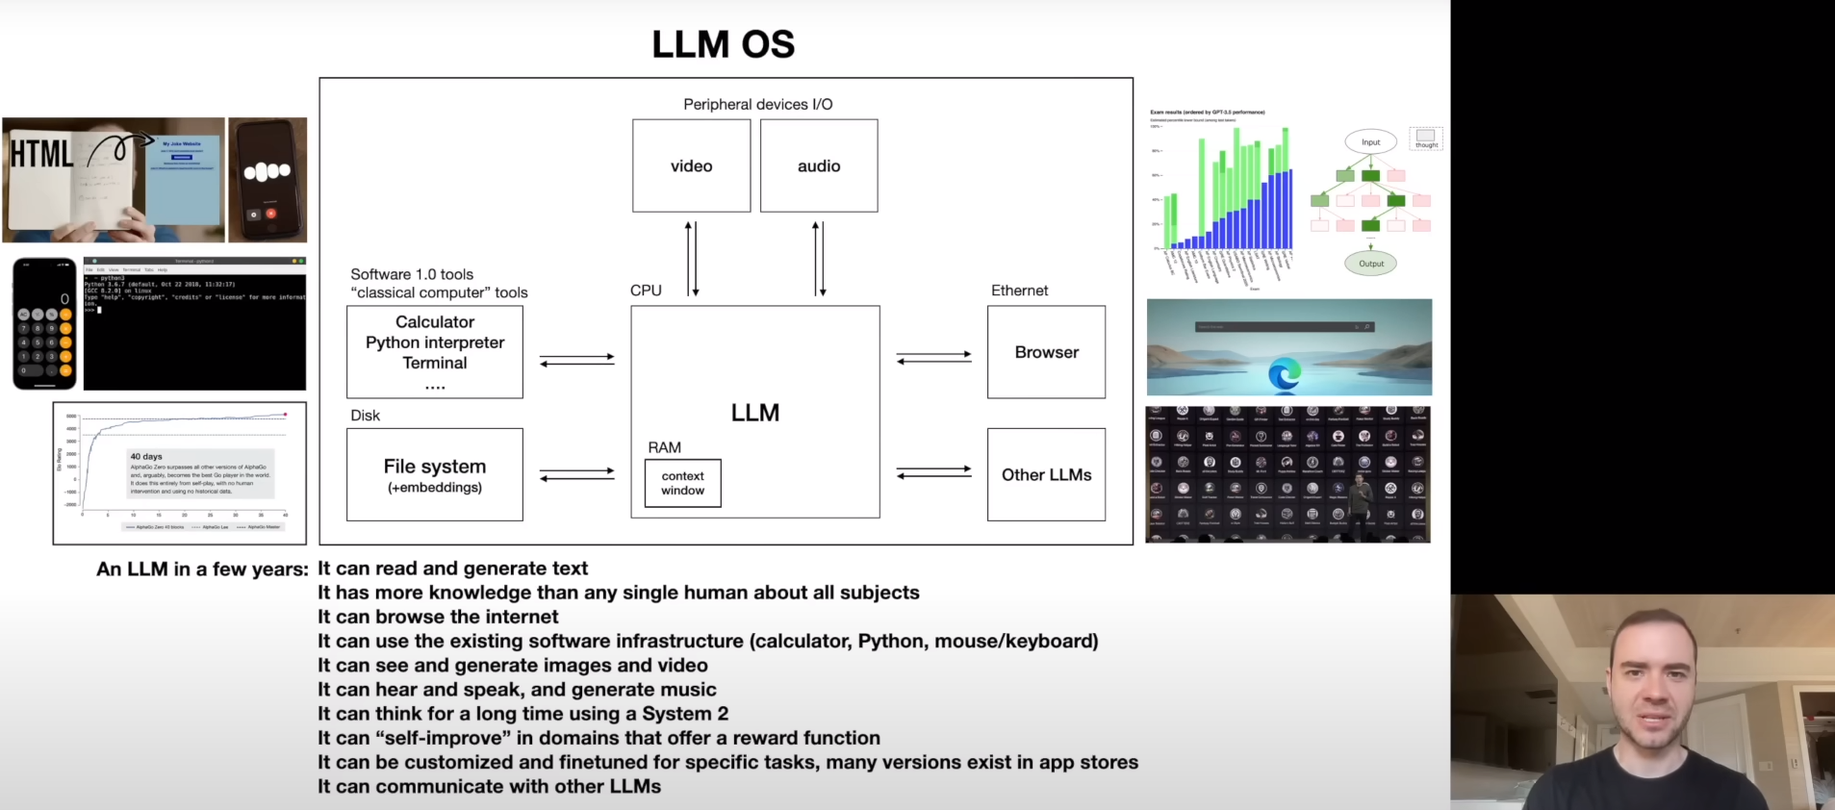
Motivation
https://youtu.be/zjkBMFhNj_g?si=tzbEcmJiV9a6_ZsF&t=2542 [1hr Talk] Intro to Large Language Models
Notes:
Can they also run an autonomous vehicle?
Or at least, in which parts of an autonomous vehicle system can LLMs produce a benefit?

Slide 7
Overview
Motivation
LLM Basics
Foundation Models
Architecture
Training Data
Fine-Tuning
RAG
Notes:
Pure language models become fewer and fewer since they are trained with other modalities (mostly image data) together
I will focus on the language models but will put them into the bigger picture since the boundaries are a bit fluent

Slide 8
Foundation Models
Definition
by Stanford University’s Center for Research on Foundation Models (CRFM) in August 2021
“A foundation model is any model that is trained on broad data (generally using self-supervision at scale) that can be adapted (e.g., fine-tuned) to a wide range of downstream tasks…” https://arxiv.org/pdf/2108.07258.pdf
any model
trained on broad data
self-supervision at scale
downstream tasks
Chat
-
G enerative
P re-Trained
T ransformer
Fine-tuned Model
(can still be Foundation Model)
Language Foundation Model
Notes:
Stanford Institute for Human-Centered Artificial Intelligence's (HAI) Center for Research on Foundation Models (CRFM) created and popularized the term (https://hai.stanford.edu/news/introducing-center-research-foundation-models-crfm)
Models pre-trained on vast amount of diverse data such that they can learn how a domain works
GPT = Generative Pre-trained Transformer

Slide 9
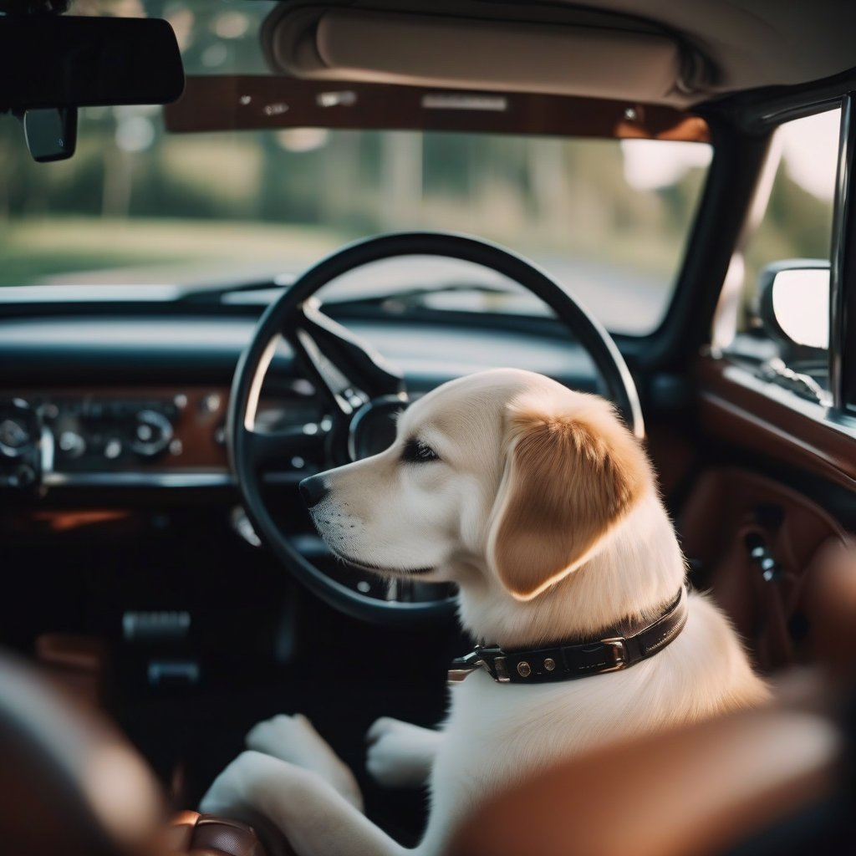
Foundation Models
Domain | Information
Image | design principles, static physics, functional utilization, …
Video | same as image + temporal consistency, agent interaction, …
Language | grammar, reasoning, knowledge, …
Dog driving a car
Stable Diffusion XL
https://huggingface.co/spaces/google/sdxl
Notes:
Stanford Institute for Human-Centered Artificial Intelligence's (HAI) Center for Research on Foundation Models (CRFM) created and popularized the term (https://hai.stanford.edu/news/introducing-center-research-foundation-models-crfm)
Models pre-trained on vast amount of diverse data such that they can learn how a domain works
GPT = Generative Pre-trained Transformer

Slide 10
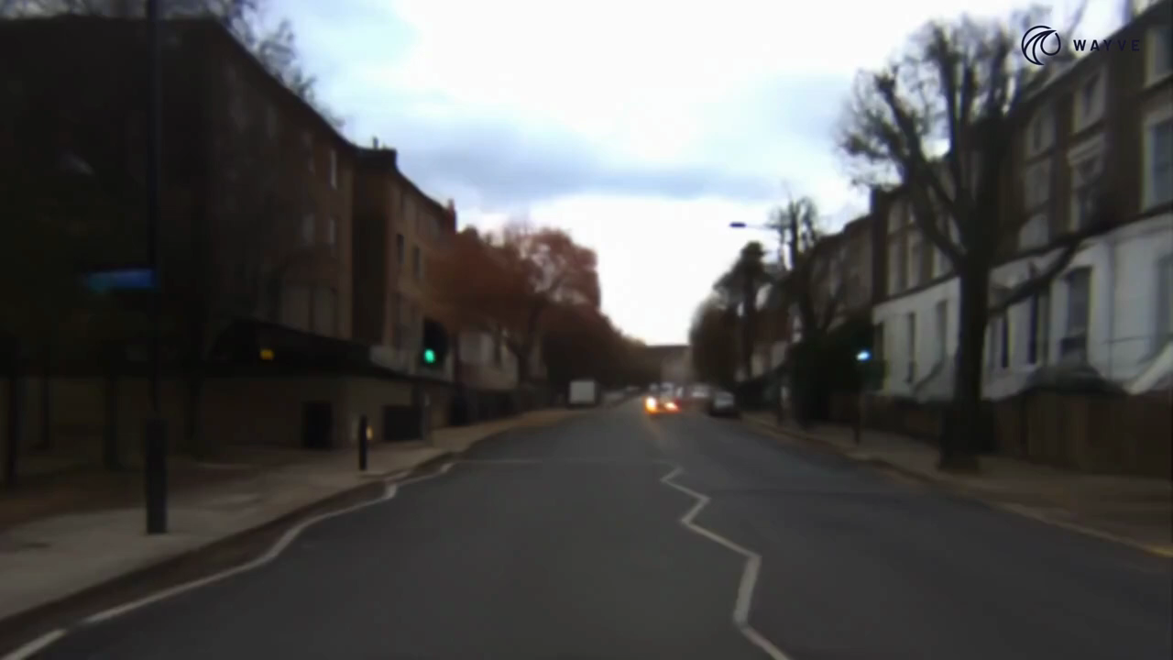
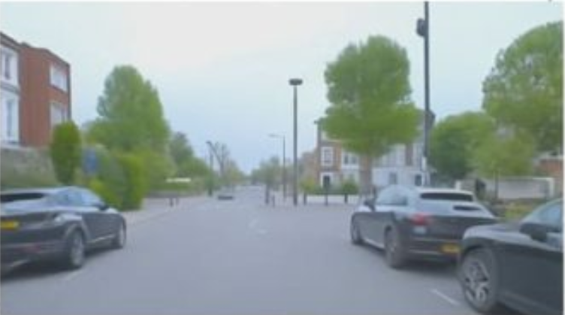
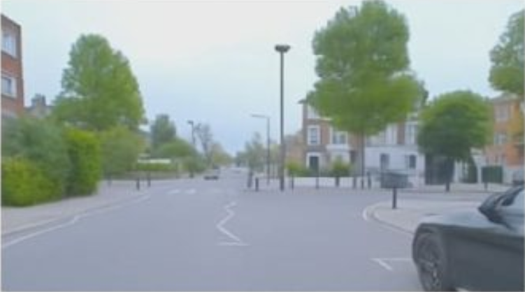
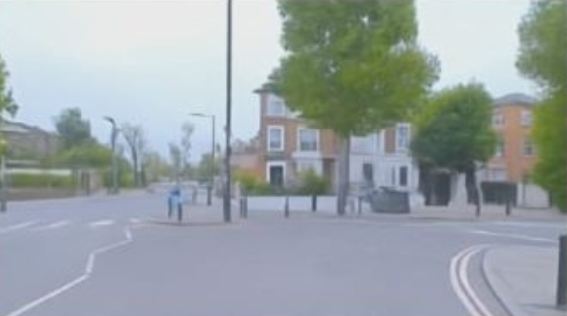
Foundation Models
Definition
by Stanford University’s Center for Research on Foundation Models (CRFM) in August 2021
“A foundation model is any model that is trained on broad data (generally using self-supervision at scale) that can be adapted (e.g., fine-tuned) to a wide range of downstream tasks…” https://arxiv.org/pdf/2108.07258.pdf
Domain | Information
Image | design principles, physics, functional utilization, …
Video | design principles, physics, functional utilization, …
Language | grammar, reasoning, knowledge, …
https://www.youtube.com/watch?v=hTd96uExb68&list=PL5ksjZd5b6SI-6MQi6ghoD-GilTPmsQIf&index=7
https://wayve.ai/thinking/scaling-gaia-1/
Here, we force our vehicle to drive toward the right and into close proximity with another vehicle. We see that the other vehicle reacts appropriately and correctly attempts to avoid crashing into us
Notes:
Stanford Institute for Human-Centered Artificial Intelligence's (HAI) Center for Research on Foundation Models (CRFM) created and popularized the term (https://hai.stanford.edu/news/introducing-center-research-foundation-models-crfm)
Models pre-trained on vast amount of diverse data such that they can learn how a domain works
GPT = Generative Pre-trained Transformer

Slide 11
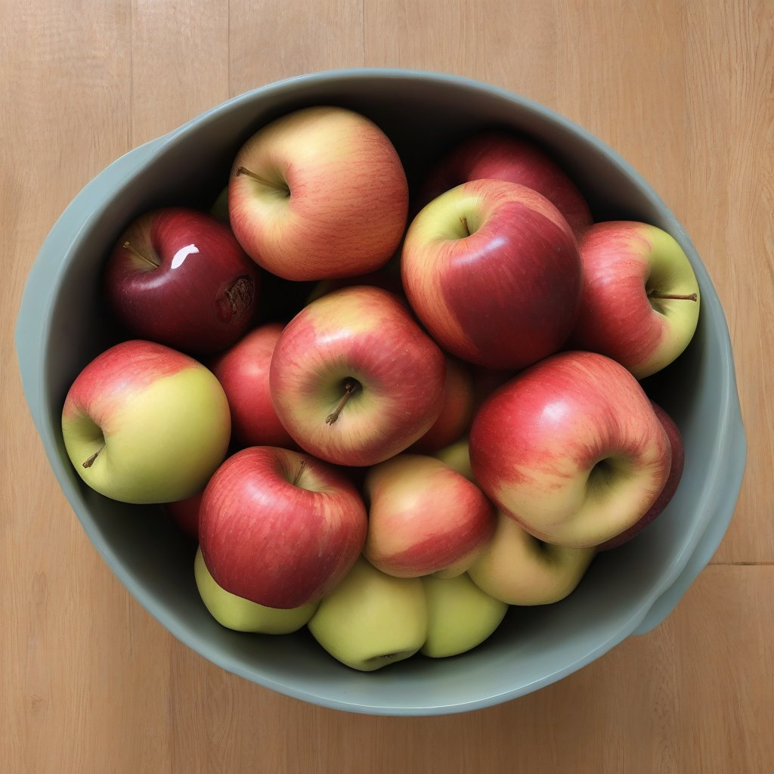
Foundation Models
Definition
by Stanford University’s Center for Research on Foundation Models (CRFM) in August 2021
“A foundation model is any model that is trained on broad data (generally using self-supervision at scale) that can be adapted (e.g., fine-tuned) to a wide range of downstream tasks…” https://arxiv.org/pdf/2108.07258.pdf
Domain | Information
Image | design principles, physics, functional utilization, …
Video | design principles, physics, functional utilization, …
Language | grammar, reasoning, knowledge, …
A fruit bowl showing the number of apples I have left if I start with three and eat one
Stable Diffusion XL
https://huggingface.co/spaces/google/sdxl
Notes:
Stanford Institute for Human-Centered Artificial Intelligence's (HAI) Center for Research on Foundation Models (CRFM) created and popularized the term (https://hai.stanford.edu/news/introducing-center-research-foundation-models-crfm)
Models pre-trained on vast amount of diverse data such that they can learn how a domain works
GPT = Generative Pre-trained Transformer

Slide 12
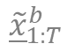
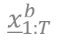
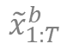
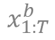
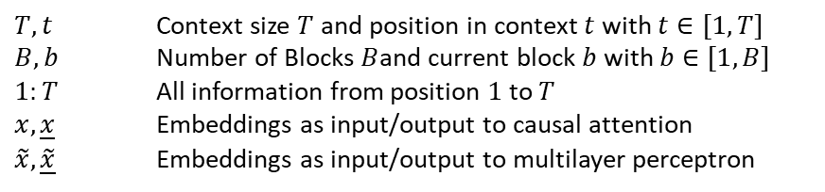
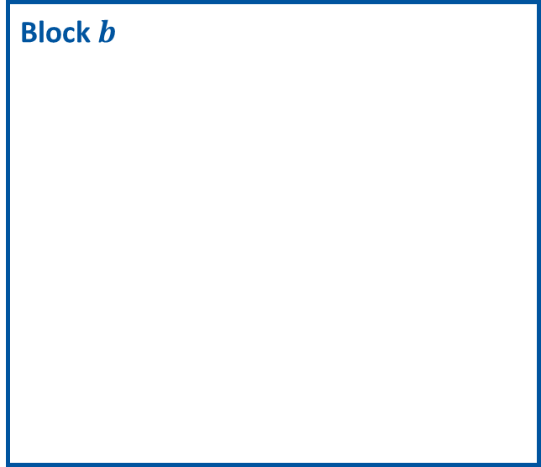
Transformer Architecture
cat is striped, and these stripes
Text prediction
$T,t$ Context size $T$ and position in context $t$ with $t∈[1, T]$
$B, b$ Number of Blocks $B$and current block $b$ with $b∈[1, B]$
$1:T$ All information from position $1$ to $T$
$x, \underline{x}$ Embeddings as input/output to causal attention
$\tilde{x}, \underline{\tilde{x}}$ Embeddings as input/output to multilayer perceptron
Block $b$
Add & Norm
$${\underline{\tilde{x}}}_{1:T}^{b}$$
Causal Multilayer Perceptron
$${\tilde{x}}_{1:T}^{b}$$
Add & Norm
$${\underline{x}}_{1:T}^{b}$$
Causal Attention
$$x_{1:T}^{b}$$
Text & Position Embedding
The cat is striped, and these
https://s3-us-west-2.amazonaws.com/openai-assets/research-covers/language-unsupervised/language_understanding_paper.pdf
Notes:
Could also attend to itself e. g. cat is striped, stripes make it look good

Slide 13





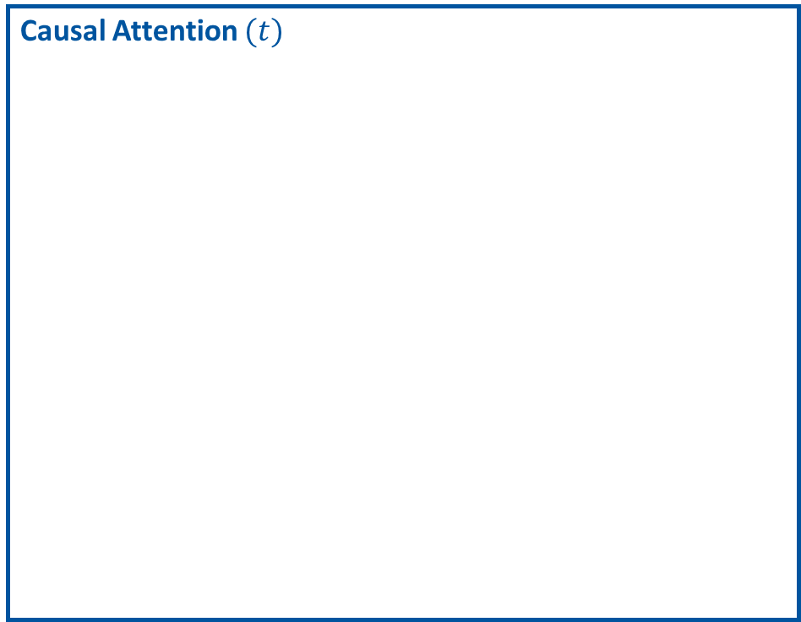
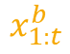
Transformer Architecture
cat is striped, and these stripes
$${\underline{x}}_{t}^{b}$$
Causal Attention $(t)$
Text prediction
Block $b$
Add & Norm
$${\underline{\tilde{x}}}_{1:T}^{b}$$
Causal Multilayer Perceptron
$${\tilde{x}}_{1:T}^{b}$$
Add & Norm
$${\underline{x}}_{1:T}^{b}$$
…
…
…
Causal Attention
Querry$(t)$
Keys
Values
$$x_{1:T}^{b}$$
Text & Position Embedding
$$x_{t}^{b}$$
$$x_{1:t}^{b}$$
The cat is striped, and these
https://s3-us-west-2.amazonaws.com/openai-assets/research-covers/language-unsupervised/language_understanding_paper.pdf
Notes:
Could also attend to itself e. g. cat is striped, stripes make it look good
Relevancy weighted mixing of information
For each embedding, you identify how relevant the information of other embeddings are, and collect their information according to that relevancy

Slide 14

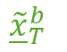
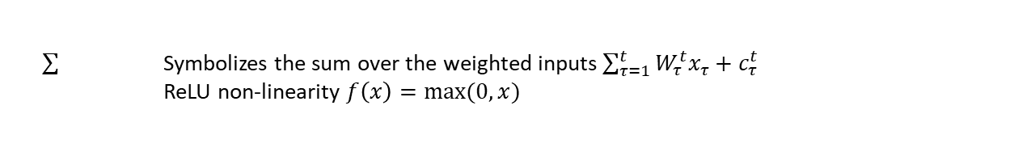

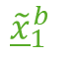

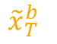

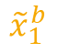

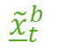
Transformer Architecture
…
…
$${\tilde{\underline{x}}}_{1}^{b}$$
$${\tilde{\underline{x}}}_{t}^{b}$$
$${\tilde{\underline{x}}}_{T}^{b}$$
cat is striped, and these stripes
Causal Multilayer Perceptron
Text prediction
Block $b$
Add & Norm
$${\underline{\tilde{x}}}_{1:T}^{b}$$
Causal Multilayer Perceptron
$${\tilde{x}}_{1:T}^{b}$$
Add & Norm
$${\underline{x}}_{1:T}^{b}$$
Causal Attention
$$x_{1:T}^{b}$$
Text & Position Embedding
…
…
$${\tilde{x}}_{1}^{b}$$
$${\tilde{x}}_{t}^{b}$$
$${\tilde{x}}_{T}^{b}$$
The cat is striped, and these
Symbolizes the sum over the weighted inputs $\sum_{τ=1}^{t}{W_{τ}^{t}x_{τ}+c_{τ}^{t}}$
ReLU non-linearity $f\left(x\right)=max⁡(0,x)$
https://s3-us-west-2.amazonaws.com/openai-assets/research-covers/language-unsupervised/language_understanding_paper.pdf

Slide 15
Datasets needed to train LLMs
https://toloka.ai/promo/large-language-models/
https://github.com/Zjh-819/LLMDataHub
Notes:
PT = Pre-Train (large amounts of data used to train generative capabilities)
SFT = Supervised Fine-Tuning (useful when clear input-> target pairs can be defined e. g. spam filtering)
RLHF = Reinforcement Learning from Human Feedback (useful for less clear input->target relations e. g. creation of poems; one can sound better then the other)

Slide 16
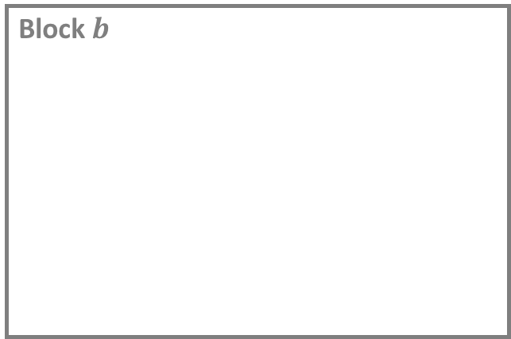

Adaptation to new Tasks
additive
AttentioFusion
selective
Text prediction
BitFit
Parallel
Adapters
LN Tuning
Ladder-Side
Attention Tuning
Block $b$
adapters
Adapters
Sparse
Adapter
Add & Norm
AdaMix
Fish-Mask
Diff-Pruning
Causal Multilayer Perceptron
LeTS
MAM
Adapters
S4
IPT
PHM Adapter
Sparse
LoRa
LT-SFT
FAR
WARP
Compacter
Add & Norm
Prefix-Tuning
UniPELT
LoRa
reparametrization
Causal Attention
soft prompts
Prompt-tuning
KronA
Intrinsic-SAID
…
Categories of current fine-tuning methods
https://arxiv.org/pdf/2303.15647.pdf
Block $1$
Text & Position Embedding

Slide 17






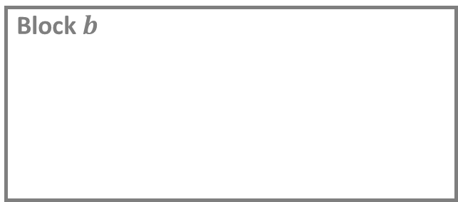

Adaptation to new Tasks
selective
additive
AttentioFusion
selective
Text prediction
BitFit
Parallel
Adapters
LN Tuning
Block $b$
Ladder-Side
Attention Tuning
adapters
MLP Block
adapters
Adapters
Sparse
Adapter
AdaMix
Fish-Mask
MLP Block
Diff-Pruning
LeTS
MAM
Adapters
S4
IPT
PHM Adapter
Sparse
LoRa
LT-SFT
Attention Block
FAR
WARP
Compacter
…
Prefix-Tuning
UniPELT
LoRa
reparametrization
reparametrization
soft prompts
Prompt-tuning
Block $1$
soft prompts
KronA
MLP Block
Intrinsic-SAID
MLP Block
Categories of current fine-tuning methods
https://arxiv.org/pdf/2303.15647.pdf
Attention Block
Text & Position Embedding
Soft Prompt
Fine-tuned compenent
Added trainable component

Slide 18




Adaptation to changing Data
LLM
Input Text
Text
Encoder
Combined
input & retrieved Text
Output Text
(Cosine)
Similarity-based
Retrieval
Retrieved
Documents
Database of
original & encoded Text Chunks
Retrieval Augmented Generation (RAG)
https://arxiv.org/pdf/2005.11401v4.pdf RAG
https://blog.langchain.dev/improving-document-retrieval-with-contextual-compression/
https://arxiv.org/pdf/2004.04906.pdf Dense Passage Retrieval

Slide 19
Overview
Motivation
LLM Basics
Foundation Models
Architecture
Training Data
Fine-Tuning
RAG
Capabilities & Restrictions
Potential in AD
Potential for Data
Potential for Testing
Potential for Driving Stack
Summary
Notes:
Pure language models become fewer and fewer since they are trained with other modalities (mostly image data) together
I will focus on the language models but will put them into the bigger picture since the boundaries are a bit fluent

Slide 20




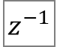
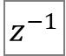
Title
Data Collection
$$z^{−1}$$
$$z^{−1}$$
Detection
Tracking
Prediction
Planning
Detections
…
…
https://arxiv.org/pdf/2212.10156.pdf

Slide 21
Title
Data Collection
Labelling
Data Synthesis
Testing
$$z^{−1}$$
$$z^{−1}$$
Detection
Tracking
Prediction
Planning
Detections
…
…
https://arxiv.org/pdf/2212.10156.pdf

Slide 22

Applications for testing
Write test requirements
You
Can you describe an intersection scenario that might be interesting to test an autonomous vehicle?
ChatGPT 3.5
Certainly! Let's consider an intersection scenario that presents challenges for testing an autonomous vehicle:
Scenario: Busy Urban Intersection with Complex Traffic Dynamics
Multi-Lane Intersection: The intersection involves multiple lanes, each with different turning options (left turn, right turn, and straight).
Dynamic Traffic Conditions: The traffic conditions are highly dynamic, with a mix of vehicles, pedestrians, and cyclists. The density of traffic varies, creating situations where the autonomous vehicle needs to navigate smoothly through both light and heavy traffic.
Unpredictable Pedestrian Behavior: Pedestrians may not strictly follow crosswalks or traffic signals. Some might jaywalk, change their walking speed unexpectedly, or be engaged in activities that distract them from the traffic.
Complex Signal Phases: The traffic signals at the intersection have complex signal phases, including left-turn arrows, flashing yellow lights, and pedestrian crossing signals. The vehicle must correctly interpret and respond to these signals to make safe and efficient decisions.
Limited Visibility and Obstructions: The presence of tall buildings or other infrastructure might limit the vehicle's sensors' visibility. The scenario includes situations where the autonomous vehicle needs to navigate based on partial sensor data and make decisions in real-time.
Simultaneous Turns and Merging: The intersection allows for simultaneous turning movements from different directions, and merging lanes create situations where the vehicle needs to yield appropriately and merge into traffic seamlessly.
Emergency Vehicles: The scenario includes the sudden appearance of emergency vehicles with lights and sirens, requiring the autonomous vehicle to respond appropriately by yielding or making way to allow the emergency vehicle to pass safely.
Adverse Weather Conditions: Introduce adverse weather conditions such as heavy rain or snow, which can affect visibility, traction, and sensor performance. The autonomous vehicle must demonstrate the ability to adapt to these challenging weather conditions.
Traffic Rule Violations: Simulate scenarios where human drivers might violate traffic rules, such as running red lights or making illegal turns. The autonomous vehicle should be capable of detecting and responding to such unpredictable behavior to ensure safety.
Testing an autonomous vehicle in such a complex intersection scenario would assess its ability to handle diverse and challenging real-world situations, demonstrating its robustness and reliability in urban environments.

Slide 23
Applications for dataset creation
Write text-based image summaries
Remove duplicates that all show straight driving on highway
Show dataset statistics
On object level (e. g. how many images of roundabouts do I have)
On scenario level (e. g. how many near crash scenarios do I have)
Find me more roundabout images
Based on given requirements, generate a couple of random scenarios for testing
Paired with image generation model, LLMs can be used to augment images

Slide 24
Applications for perception
Enhanced detection: provide contextual understanding to improve classification and detection
Explainability: describe why the model focuses on certain objects
Used for users to interact with system to feel more secure
Can be used for reporting to debug later
Textual scene description that captures the whole context and can be used for path planning

Slide 25
Applications for tracking
Context-aware adaption of tracking parameters
Textual behavior descriptions (e. g. is braking, is accelerating, …)
Natural language annotations to describe objects for reidentification

Slide 26
Applications for occupancy prediction
Predicted future behavior

Slide 27
Applications for planner
Textual information about driving intend + explaination
Used as low-level planner
Used as high level planner
LLM to generate code that describes RL reward function
LLM using RAG to adapt driving policy online to adhere to region specific regulations

Slide 28
Motivation

Slide 29
https://github.com/christianholland/AachenColorPalette/blob/master/data-raw/aachen_colors.csv?plain=1
Notes:
Typically, verification is said to be about 'building the thing right' while validation is about the 'building the right thing'. In other words, verification is about checking against engineering specifications, while validation is about checking against user needs.

